Slide 1
Majlis Ansarullah Monthly Meeting
March 2016
This slide deck contains images licensed for the purpose of this presentation only.
No one is permitted to use the images for any other use, without prior permission.

Slide 2
AGENDA
Recitation of the Holy Quran (30:22)
Pledge
Reminders: Recitation of HQ and Congregational Prayers
Monthly topic: What does a truly successful marriage mean?
Health topic: Vitamins
National Reminders/announcements
Local Reminders/announcements
Dua

Slide 3
Why read the Holy Quran regularly?
THOSE WHO HONOR QURAN SHALL BE HONORED IN HEAVEN
Do not leave Holy Quran like a book that has been forsaken, since it there in, and no where else that life lies. Those who honor this Holy Book shall be honored in heaven. Those who will hold the Holy Quran superior to every tradition and every other sayings shall be given preference in heaven.
Our Teaching, Page 12

Slide 4
Watching Our Congregational Salat!
Offer Prayers in Congregation so we are Following the Sunnah of Holy Prophet (SAW):
According to Abdullah bin Masoud (ra), the Holy Prophet (saw), said: "O Muslims! Allah has prescribed paths of right guidance for you among which is the offering of the daily prayers in congregation in the masjid, if you start saying your prayers individually at home, as so-and-so does, you will be forsaking the Sunnah of your Prophet, and if you forsake the Sunnah of your Prophet, you will certainly be going astray.“
(Muslim)

Slide 5
What does a truly successful marriage life mean?

Slide 6
Click to listen the recitation
[30:22] And one of His Signs is this, that He has created wives for you from among yourselves that you may find peace of mind in them, and He has put love and tenderness between you. In that surely are Signs for a people who reflect.

Slide 7
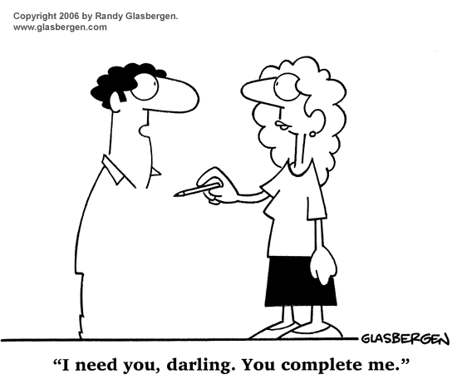
Finding “peace of mind”
How can we give our wives peace of mind?
Share your thoughts

Slide 8
Guidance from the Promised Messiah (as)
“The relationship between husband and wife should be as between two true and sincere friends. The primary witness of a person’s high moral qualities and of his relationship with God is his wife. If his relationship with his wife is not good, it is not possible that he should be at peace with God. The Holy Prophet, peace and blessings of Allāh be upon him, has said, ‘The best of you are those who behave best towards their wives.’”
(Malfūẓāt, Vol. V, pp. 417-418)

Slide 9
Discussion I
I am often frustrated with my wife’s management of the household. She’s careless with food preparations, finances and the upbringing of our children. Last night, it got so bad that I yelled at her so loudly that the kids woke up. What should I do first?

Slide 10
Option 1: I should immediately offer two nawafal prayers that Allah ta’ala may correct the situation.
Option 2: I should apologize to her and the children for yelling. It won’t happen again.
Option 3: I should explain to the family how we have to work together to manage the household affairs.
Option 4: Any other response?

Slide 11
Guidance from the Promised Messiah (as)
Standing Up to Women
“I esteem a person who stands up against a woman is a coward and unmanly. If you study the life of the Holy Prophet, peace and blessings of Allāh be upon him, you will find that he was so courteous, that despite his high dignity, if an old woman stopped to talk to him, he continued to listen to her till she let him go.”
(Malfūẓāt, Vol. IV, p. 44)

Slide 12
Discussion II
There is deep mutual love and tenderness in your marriage. However, you have noticed over the years that your wife can be very jealous. Your female boss texted you about a work matter late at night, but it also included some back-and-forth playful (platonic) chit-chat. You quickly delete the texts, but your wife heard the message chimes and wants to know why there are so many texts at this late hour.

Slide 13
Option 1: Tell her your boss texted you about a certain work-related matter.
Option 2: Tell her the texts are from your boss and you always delete texts after reading them.
Option 3: Tell her they were texts from your boss and the reason you deleted them.
Option 4: Any other response?

Slide 14
Guidance from Hazur (aba)
The Path to Forgiveness
“The basis of the mutual confidence built after marriage should also be on Qaule Sadīd; on what is clear, unambiguous and truthful. Allah knows human nature and has given upholding truth as the basic instruction for societal peace to help fulfil mutual relationships and live in peace and well-being. It should be a truth, which is not confusing in any way at all. It is stated that if one promises to always say what is clear and unambiguous and not go near lies and misinformation, Allah guarantees forgiveness of sins. One’s deeds will be reformed, and obviously when deeds are reformed and one works to gain the pleasure of Allah, then Allah also loves that person.”
Excerpt from address by Hadhrat Khalifatul Masih v (aba) UK Jalsa Salana 7/23/11
Notes:
Tahir Bhai – can you get the actual audio clip for this so we can play the video?
Rizwan Bhai – 44:30 to 45:35 http://www.alislam.org/v/1673.html

Slide 15
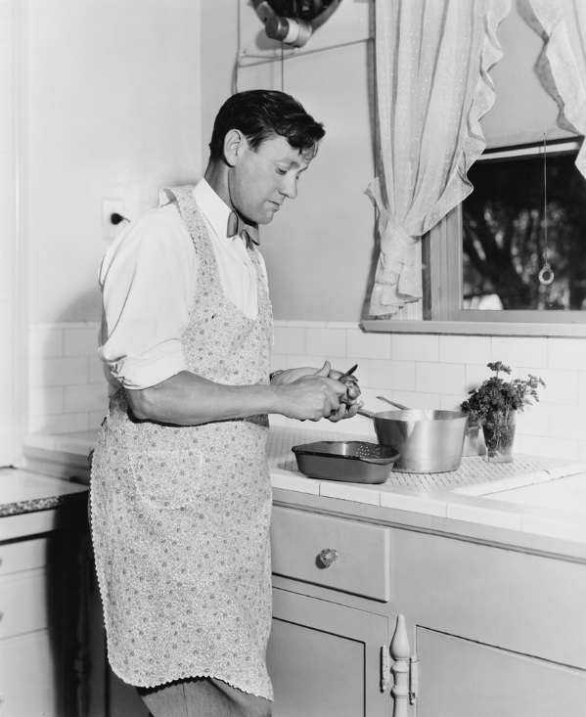
Discussion III
I found out from an Ahmadi brother that my wife mentioned to his wife that I don’t help out around the house with chores and properly deal with our children. She said that even my parents come and visit often but do not help much. I am not sure how to deal with this?

Slide 16
Option 1: I would explain to my wife that the household is her responsibility and mine is to focus on providing food and shelter.
Option 2: I would chastise my wife for talking about family matters so loosely with others in the Jama’at.
Option 3: I would ask my wife how my family and I can better help around the house.
Option 4: Any other response?

Slide 17
Guidance from the Holy Prophet (saw)
Showing Kindness to Your Wife
It is narrated by Abū Hurairah (may Allāh be pleased with him) that the Holy Prophet (peace and blessings of Allāh be upon him) said, “Among the believers, most perfect in faith are those who have the best disposition, and the best among you are those who are kindest to their wives.”
(Tirmidhī, Kitābun-Nikāḥ)

Slide 18
A Short Video from Jalsa Sermon, Nov 10, 2006

Slide 19
Translation of Video
Huzur reads a verse of the Holy Quran. You treat them well in everyday life. If you dislike them, it is very likely that you dislike a thing and Allah blesses it a lot. So when marriage takes place, kindness demands that you bear with and treat each other gently, understand each other and fear Allah. Allah Ta’ala says that if being obedient to Him, you will try to be kind to each other, then anything which you apparently dislike may change to likeness. And you may get a lot of goodness and blessing from this relationship because you don’t know the unseen but Allah knows what is hidden and has control over everything. He will create goodness and blessing in it for you. Hazrat Khalifatul Mash I (ra) says that once I came to know about a man that he does not treat his wife well and rather is very rude to her. Huzur says that one day he came across me on my way somewhere. I advised him in the light of this verse [which Huzur recited earlier]. From there, that man went straight to his home and said to his wife that you know that I have been treating you like enemies but today Maulana Noorud Din Sahib (ra) has opened my eyes. From now on, I will treat you well. Hazrat Khalifatul Masih (ra) says that after that, Allah Ta’ala rewarded that man with many blessings he had four very beautiful children and they lived happily thereafter.

Slide 20
In the past week, how many times: - did you yell at your wife? - did you not speak the full truth with your wife?
اپنے جائزے لیں -
Self analyze yourself, KMV
Sum the numbers and keep to yourself.
That number is for your own self-reflection

Slide 21
How to Improve?
اپنے اندر پاک تبدیلیاں پیدا کریں -
Bring about pious changes in yourself
0
Combined Score
>4
Seek openly from your wife feedback on how you can be a better husband
Keep working at it. Communicate to your wife what specific misbehavior you are trying to avoid completely
Ponder over the Holy Prophet’s (saw) treatment of his wives. Convince yourself of the need to change first

Slide 22
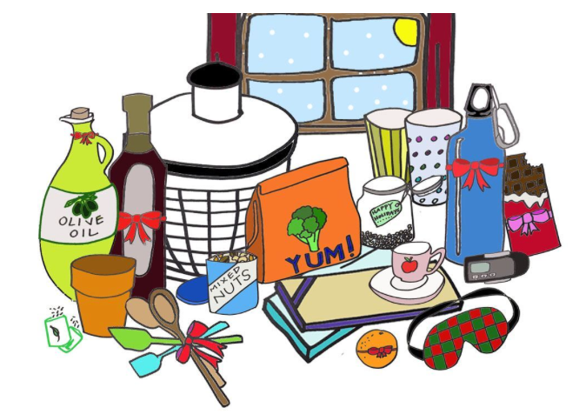
Health Topic: Vitamins & Supplement

Slide 23
What are Vitamins
Vitamins are a group of substances we need for normal body functions, growth and development
A vitamin deficiency can occur when we do not eat enough fruits, vegetables, beans, lentils, whole grains and fortified dairy foods
Vitamin Deficiency may increase risk of heart disease, cancer and poor bone health
The best way to get all the daily vitamins is to eat a balanced diet containing variety of fruits, vegetables, fortified dairy foods, legumes (dried beans), lentils, and whole grains
If you take Vitamins and supplements, DO NOT take more than 100% of the Recommended Dietary Allowance (RDA)
There are no benefits in taking mega doses of vitamins; high doses of certain (D E K A) vitamins can be harmful and even toxic

Slide 24
Benefits Vs Harm
Vitamins and minerals are essential to life, and experts say that the diets of many Americans fall short in some key nutrients
Daily multivitamin/mineral pills are the most popular supplements in the US; If they have an effect—good or bad—it is likely to be small
Evidence suggests that multis provide little or no benefit for most well-nourished people (People who are most likely to take them)
Those most likely to benefit from supplementation— is to people who are truly malnourished—and they are least likely to take them
Vitamins are very useful in certain disease states and special conditions e.g. if you eat a vegetarian or vegan diet, in pregnancy and lactation and true deficiency states

Slide 25
How to get your Vitamins?
Balanced Nutrition is always better than a Pill
Meet recommended nutrient intakes by adopting a balanced eating pattern
Consume a variety of nutrient-dense foods and beverages and limit the intake of saturated and trans fats, cholesterol, added sugars, salt, and alcohol
If you're over age 50, consume vitamin B-12 in fortified foods or supplements
If you are an older adult, have dark skin, or are exposed to insufficient sunlight exposure, consume extra vitamin D from vitamin D-fortified foods and/or supplements

Slide 26
National Reminders
Book assignments for first half of 2016
1. Philosophy of the Teachings of Islam
2. Blessings of Prayer
3. How to be free from Sin
4. The Will
5. Lecture Ludhiana

Slide 27
Local Reminders
Dua

